Slide 3

scribe

Slide 5
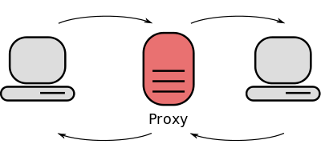
proxy

Slide 7

Business representative

Slide 9

sponsor

Slide 11

entrepreneur

Slide 13
Expected benefits

Slide 15
Product ‘Ownership’

Slide 17
Reactive

Slide 19
Proactive

